Slide 1
Apache Spark internals

Slide 2
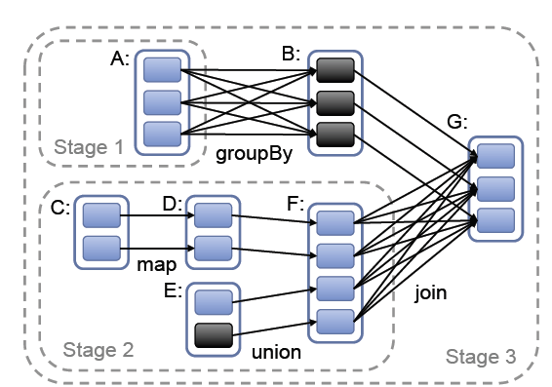
Representing RDDs
Spark builds a graph of the workflow.
Two key elements of the graph are
A set of partitions which are atomic pieces of the data set
A set of dependencies on parent RDDs

Slide 3
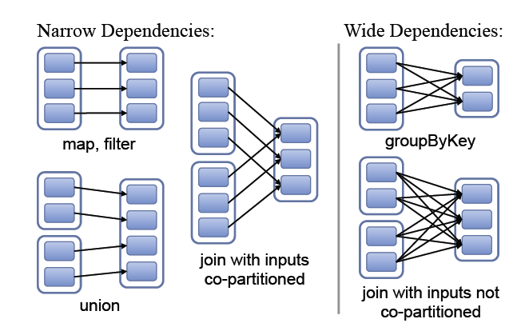
Classification of Dependencies
Spark classifies dependencies into two types
Narrow Dependencies
Where each partition of the parent RDD is used by at most one partition of the child RDD.
Allows for pipelined execution on one cluster node.
A sequence of operations involving narrow dependencies can be computed on the same node without any need for communication with any other node.
Pipelining means the computations can happen in parallel without any node needing to wait for any other node.
E.g. A map followed by a filter on an element-by-element basis

Slide 4
Classification of Dependencies
Wide dependencies
Where multiple child partitions may depend on one partition
For example groupByKey is a wide dependency since a child partition may need data from more than one parent partition.
Wide dependencies do not allow for pipelining since they require data from all parent partition to be available to be shuffled across the nodes using a MapReduce like operation.

Slide 5
Impact of dependencies on Recovery
Narrow dependencies is more efficient for recovery since only the lost parent partitions need to be recomputed.
For wide dependencies a single failed child node might need some data from all the ancestors RDDs, requiring a complete re-execution.

Slide 6
Fault Tolerance
For wide dependencies
To speed up recovery spark materializes intermediate records on the nodes that hold the parent partitions to simplify recovery.
Similar to MapReduce materializing map outputs
If a task fails, spark re-run it on another node.

Slide 7
Job Scheduling
When an action is run on a RDD, the scheduler examines the RDD lineage graph to build a directed acyclic graph of stages (DAG) to execute.
Each stage contains as many pipelined transformations with narrow dependencies as possible.
The boundaries of the stages are the shuffle operations required for wide dependencies.
The scheduler always tries to move the computation to the data (where the RDD resides).

Slide 8
Job Scheduling
For the above example the map and union are all within the same stage (stage 2) because they do not contain any wide dependencies and therefore the operations within the stage can be pipelined.
It is interesting to note that going from RDD B to G is a narrow dependency because in the above example the groupBy key is the same as the join key.
This means the data within in RDD B is already partitioned.
The actual way this would be implemented is that the data in F will be shuffled to nodes that contained the partitioned B and joined on those nodes.
This means that the data in B do not need to move across the network at all.

Slide 9
Checkpointing
Sometimes a job has many many steps.
This creates very long lineage graphs.
If a node crashes there maybe a lot of work that needs to be redone
In order to speed up recovery, RDDs are checkpointed to stable storage.
In general checkpointing is most useful for wide dependencies and long lineage graphs.

